Slide 1
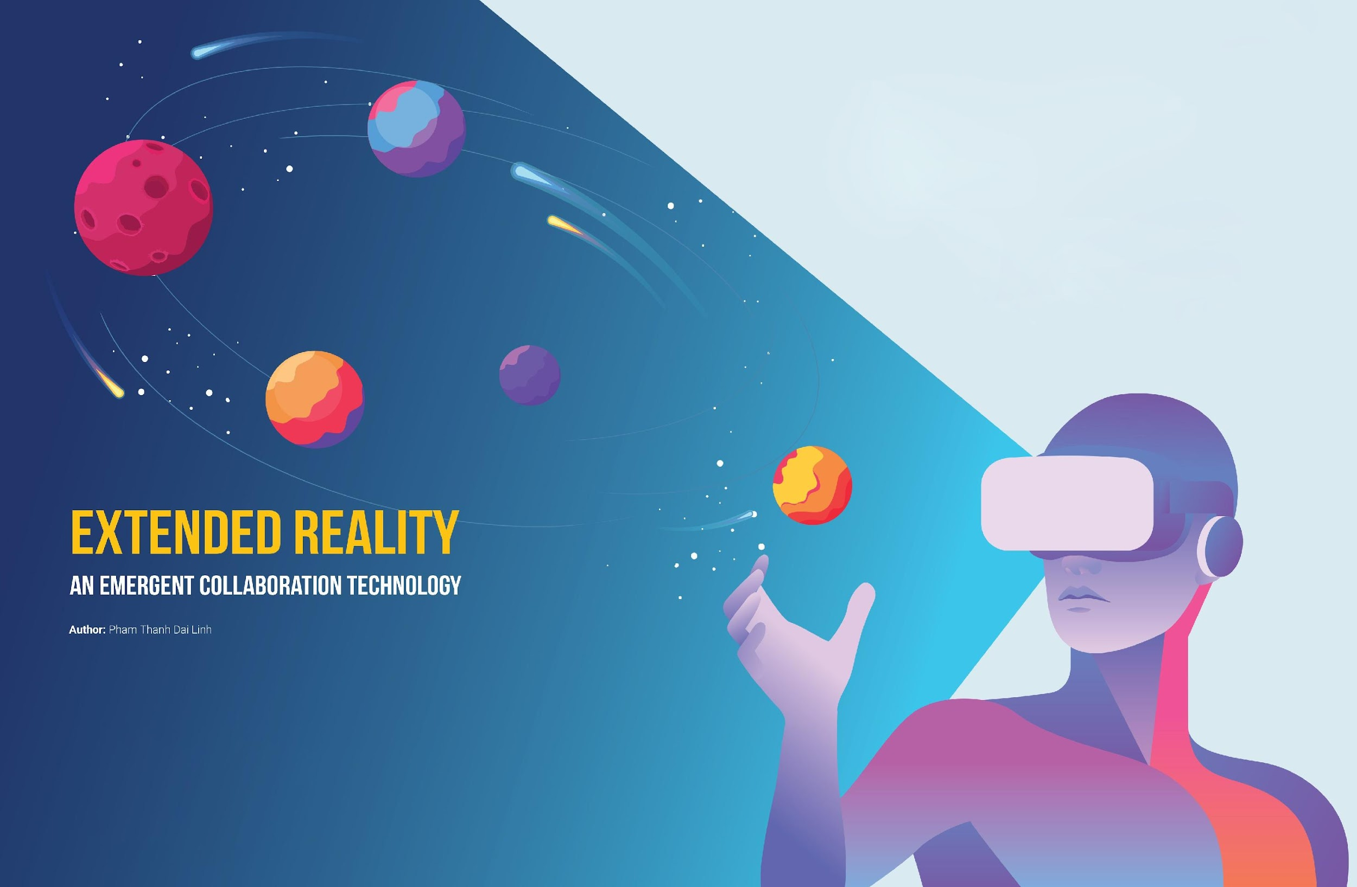
XR for k-12 Education
Case Study - 1
PresentedBy:
1. Pushpa 3. Sagar
2. Rashmi 4. Hemanth
5. Mahantesh B. 6. Ijaz H
Guided By: Mohammad Tahir Mirji (L2)

Slide 2
Overview
Introduction to Types of AR
Problem Statement For Industry
Existing System
Proposed System
Proposed Algorithm
System Implementation
Measuring Success

Slide 3
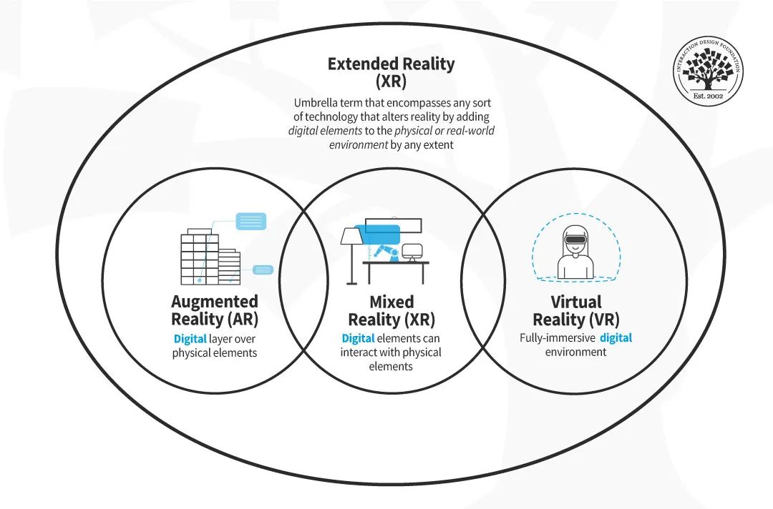
Introduction to - XR
Extended Reality (XR) is an umbrella term encapsulating Augmented Reality (AR), Virtual Reality (VR), Mixed Reality (MR), and everything in between.

Slide 4

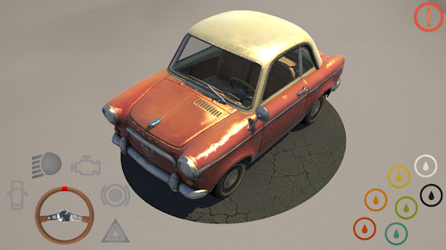
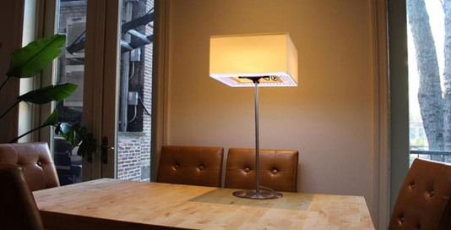
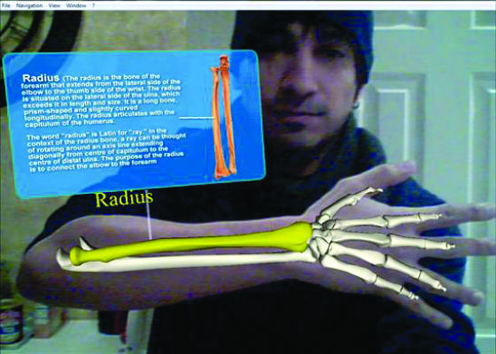
Introduction to Types of AR
What is Augmented Reality (AR)
An enhanced version of reality where live direct or indirect views of physical real-world environments are augmented with superimposed computer-generated images over a user’s view of the real-world, thus enhancing one’s current perception of reality.
Types of Augmented Reality
Marker Based AR
Markerless AR
Projection Based AR
Superimposition Based AR

Slide 5
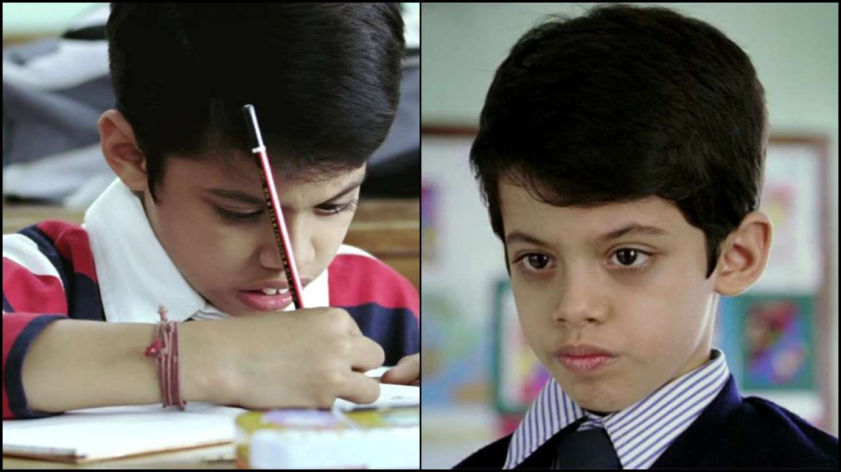
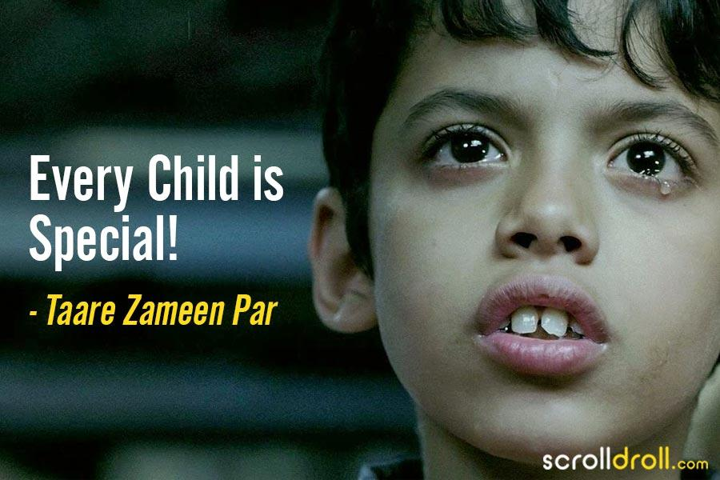
Existing System
The current educational system in our country is Physical model education system. the current system has video projection and the pattern in which learning disabled student should hook up with the topic is slow.
✓ Focus is on Textbook Knowledge, where they could be fun applied to learn.
✓ Amount of work provided is more and lead stress
✓ Most knowledge is memorized
✓ Examinations are focused on results rather than continuous learning

Slide 6
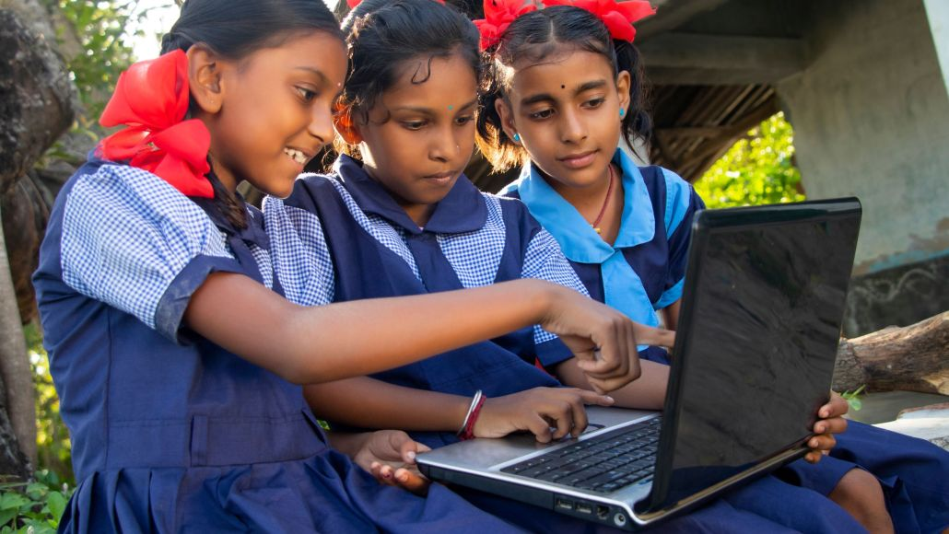
Why it’s alarming to implement in India
About 2 crore out of school children will be brought back into main stream under NEP 2020.
With emphasis on Early Childhood Care and Education, the 10+2 structure of school curricula is to be replaced by a 5+3+3+4 curricular structure corresponding to ages 3-8, 8-11, 11-14, and 14-18 years respectively.

Slide 7
Problem Statement for K-12 Education Domain
Different levels of Learning Disability (LD) has be affected millions of people in India and on an average each class has five students with Learning Disability symptoms.
The symptoms can be linked to identification, assessment or social activities.
It is known that children have great imaginative power and needs something interactive and visualized world, where they can play and learn by themselves.
This will help all children including Learning disabled children to be more interactive with their beginner study process.
The application developed using AR will help Learning disabled children to learn, understand and imagine easily.

Slide 8
Proposed System
Augmented Reality technology for developing application for kids to enhance their learning experience.
Allows them to have hands on experience with the device and can learn my themselves.
Enables play and study mode.
The implementation show the superimposition of 3D object on a tracker which will give the real object view to the user with the related audio output so that a child can easily understand and learn.
Merits
Enjoyment along with study
Better imagination
Models displayed looks real, which attracts attention.
Child can self-learn

Slide 9
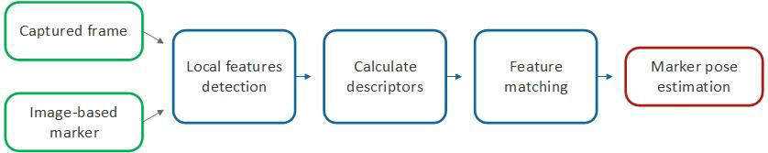
Implementation of AR Technology for K-12
Scale-invariant Feature Transform (SIFT)
The SIFT is a feature detection algorithm in the field of computer vision which is used to find and explain regional features in images.
Compare each element from the new image in the database and find identical features
From all the matches, subsets of key points which agree on the object and its scale, orientation and position with respect to new image are identified to refine good matches and consistent clusters is performed.
Every group with three or more features detected on the object are captured and model verification is performed and subsequent outliers are declined.

Slide 10
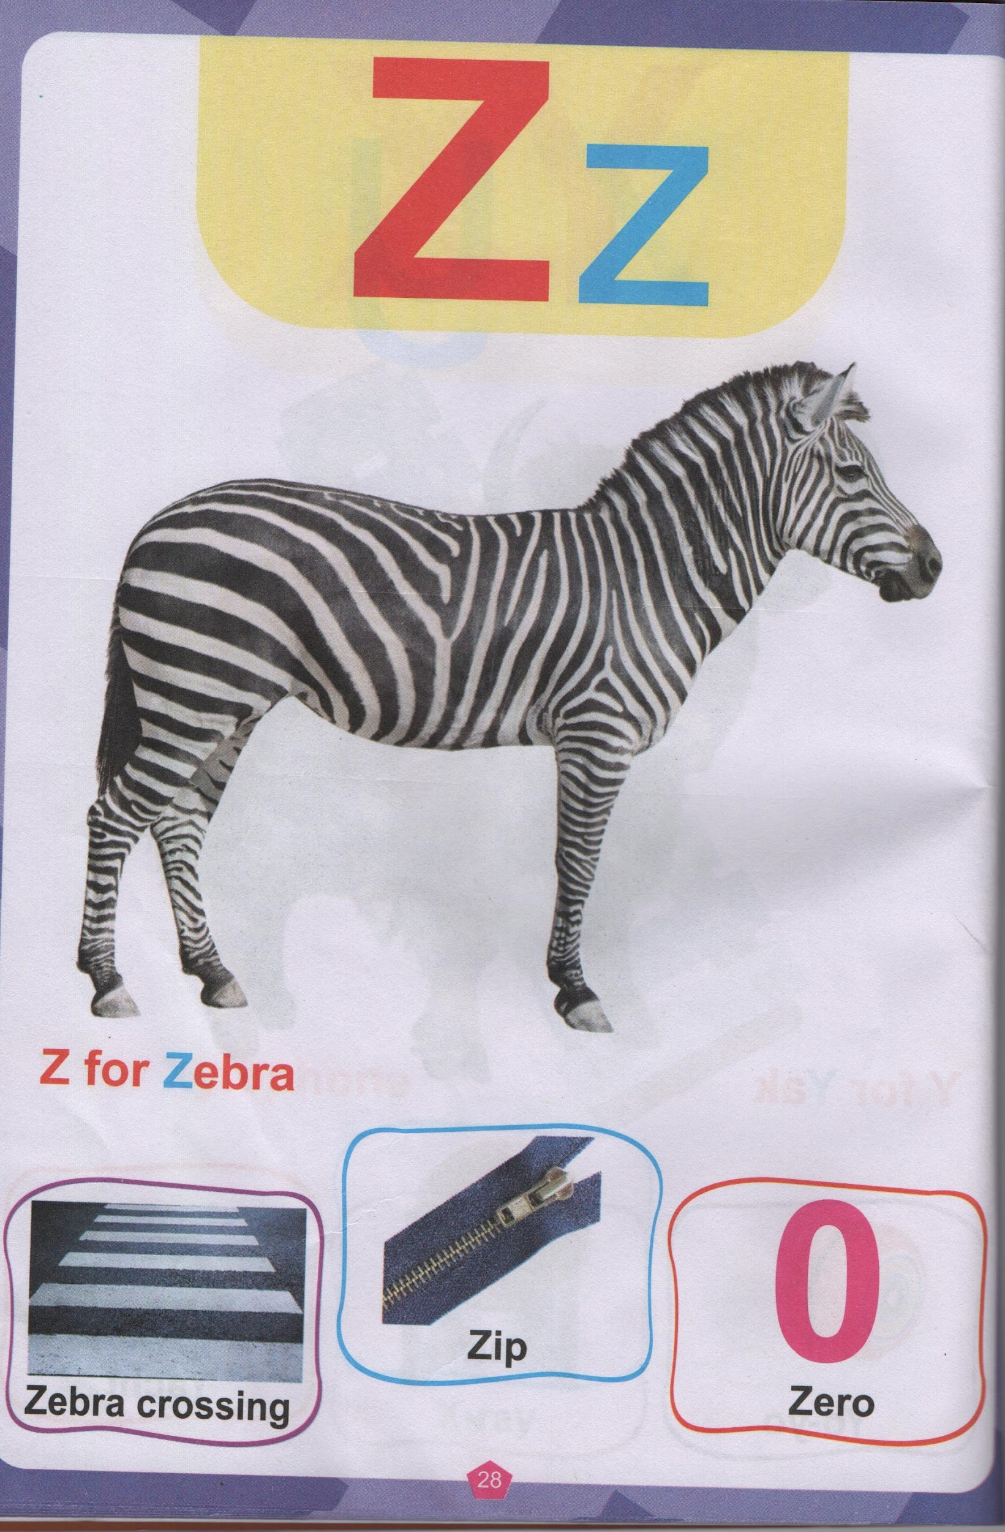
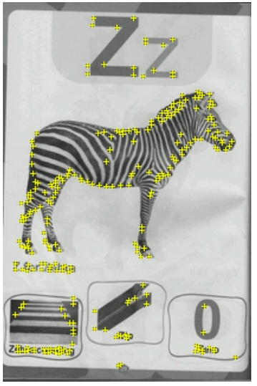
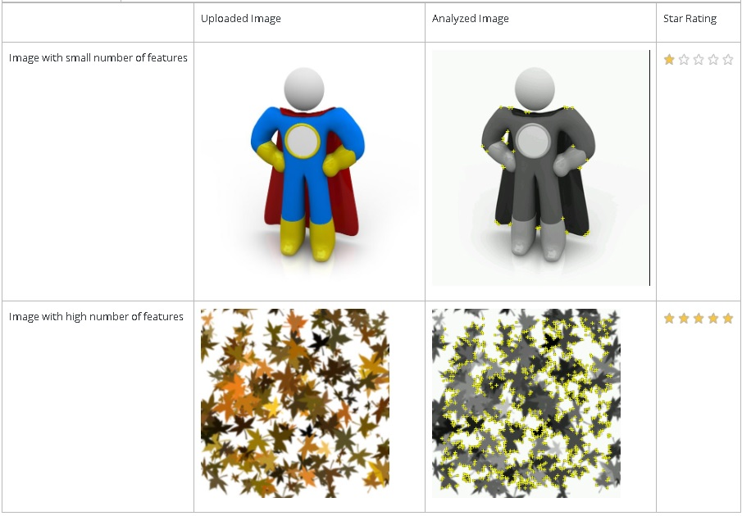
How we trained our Machine Learning Model
Finally with the obtained probability for a particular set of features point out the presence of an object is computed.
A feature is a sharp, spiked, chiselled detail in the image, such as the ones present in textured objects. The image analyser represents features as small yellow crosses. Increase the number of these details in your image, and verify that the details create a non-repeating pattern.

Slide 11
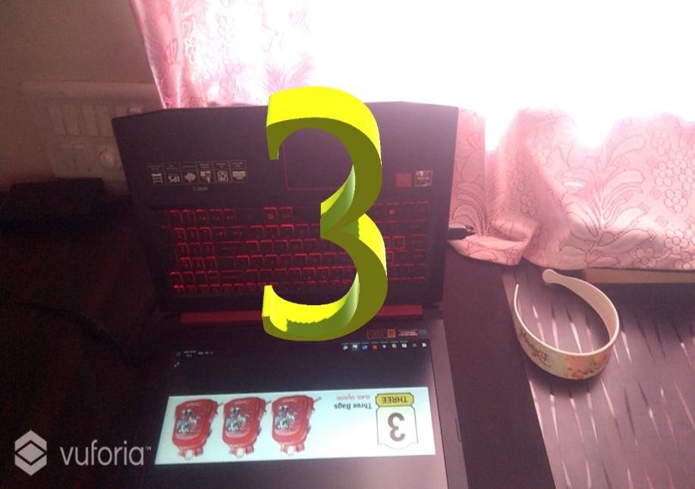
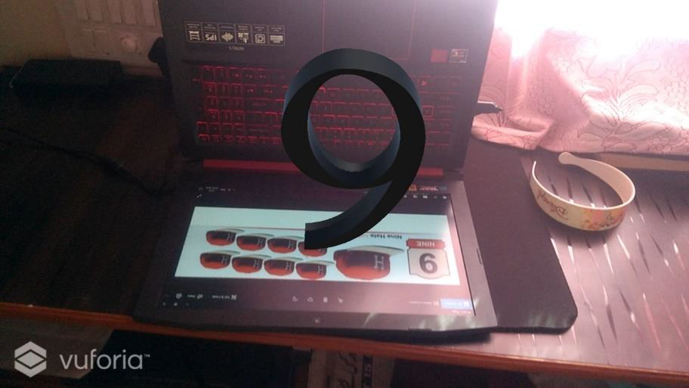
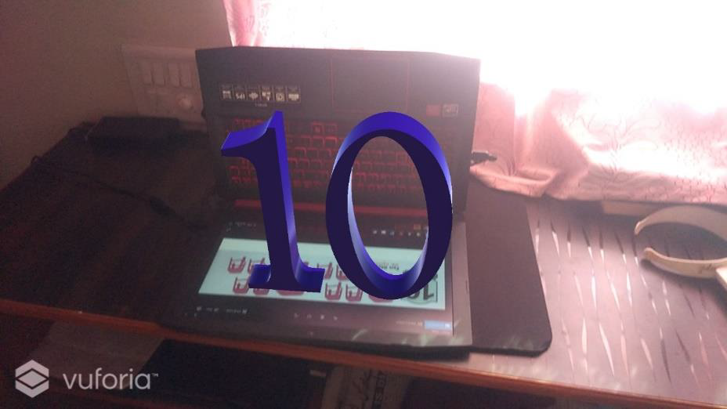
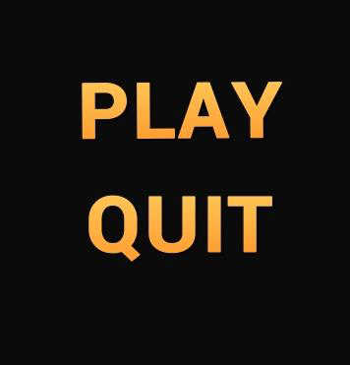
Application Output For Product Demo
Our Application output demonstration:

Slide 12
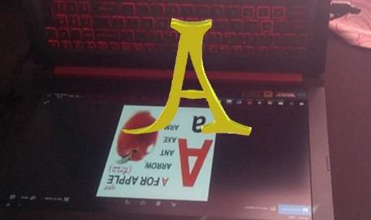
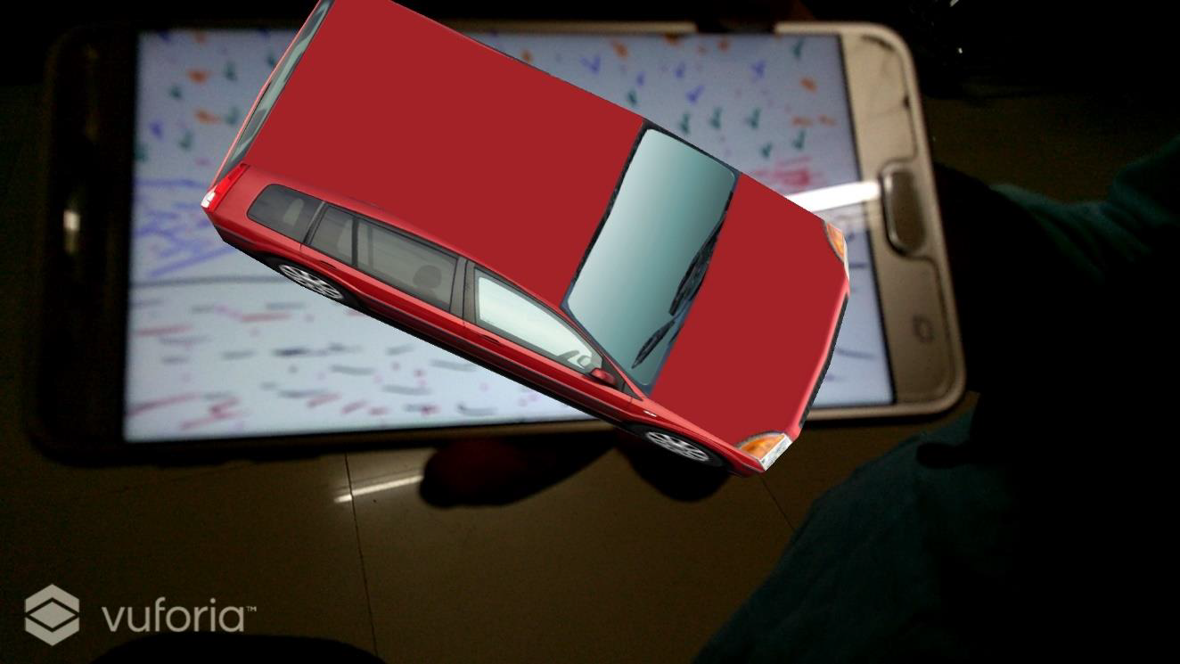
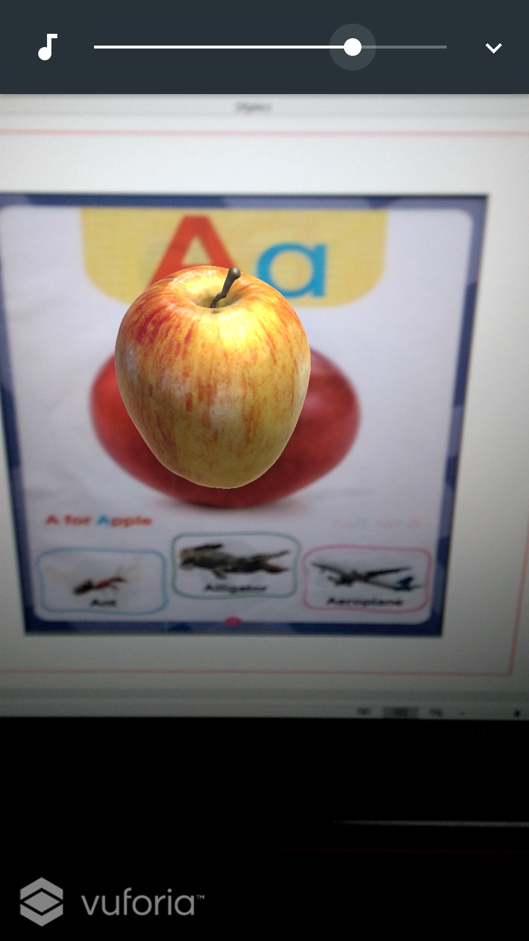
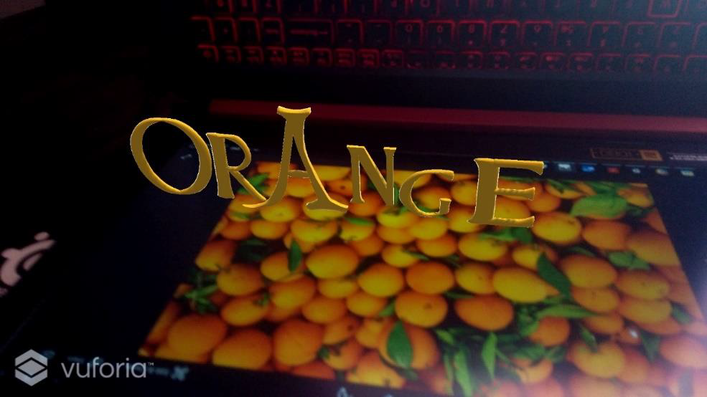
Application Output For Product Demo

Slide 13
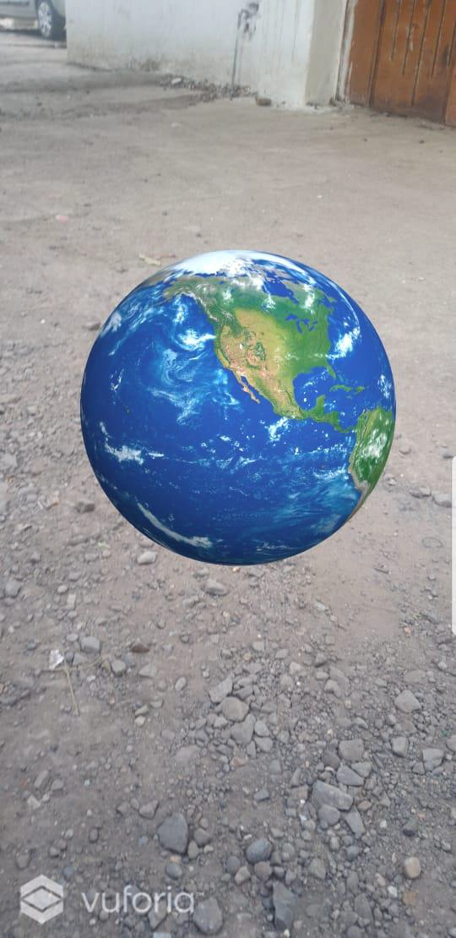
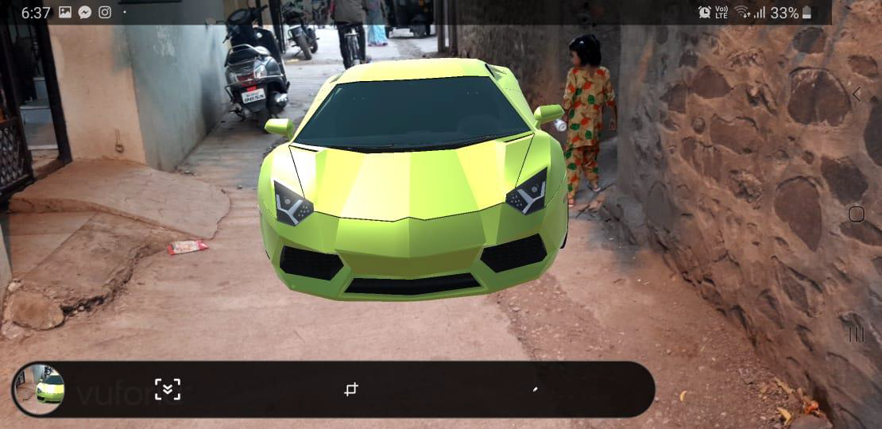
Markerless AR Application Product Implantation Demo

Slide 14
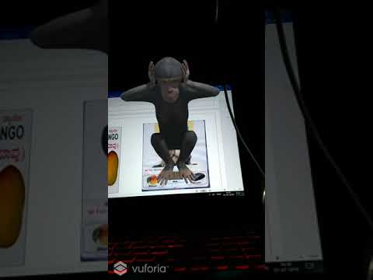
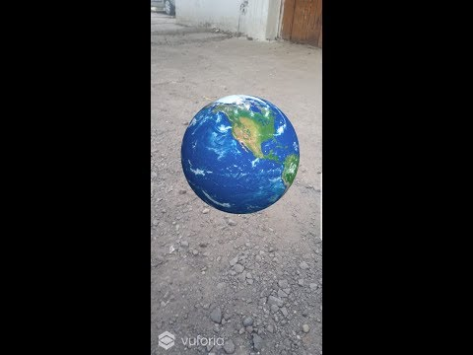
Application video Link
Marker Based AR App Markerless AR App

Slide 15
Goals We Want to Achieve
The fundamental goal of this project is to see an improvement in learning Disabled Children so that they can focus , learn and enjoy simultaneously.
This application has been imposed with 3D models , related sound and movements which can be a medium for self-learning.
The improvement in child’s imagination and a new experience to learn will make children actively participate.
The improvement in child’s imagination and a new experience to learn will make children actively participate.

Slide 16
Measuring Success of Implementation
Measuring the outcome from learning impact using our product.
If 2 crore out of school children will be brought back into main stream under NEP 2020, we believe our mission has taken a shape in real india which lives in village to create inclusive in policy level.

Slide 17
Marketing the product
Market it by visiting schools for demo
Marketing on school level meetings in each districts
Spreading awareness in parents about the app through SMS marketing

Slide 18
THANK YOU
For Feeling what we felt for rural india

